Slide 1
Machine Learning

Slide 2
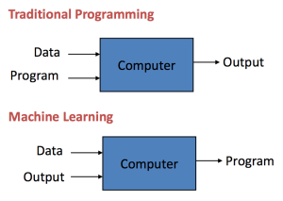

Slide 3
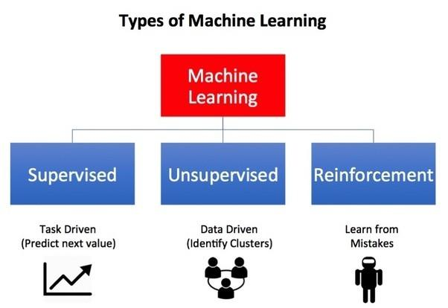

Slide 4
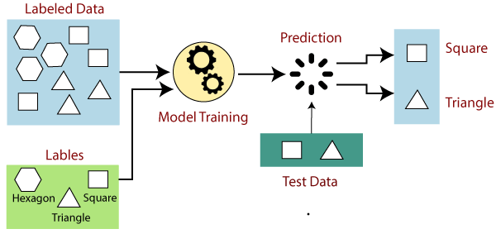

Slide 5
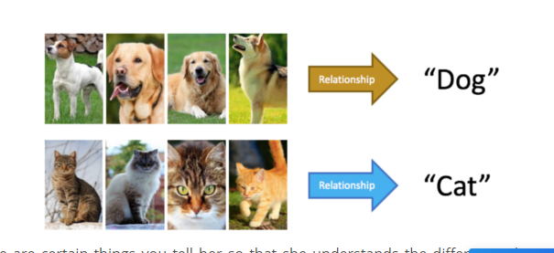
Supervised Learning : Common Applications
Advertisement Popularity
Spam Classification
Face Recognition

Slide 6
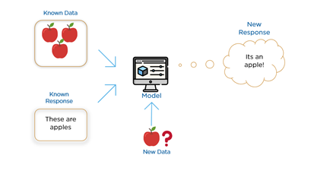
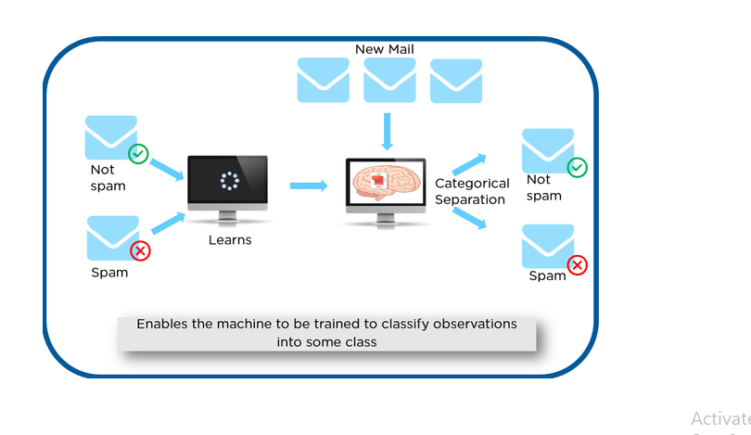
Supervised Learning : Itis the first type of machine learning, in which labelled data used to train the algorithms.

Slide 7

Types of Supervised Learning
Supervised Learning has been broadly classified into 2 types.
Regression
Classification
Regression is the kind of Supervised Learning that learns from the Labelled Datasets and is then able to predict a continuous-valued output for the new data given to the algorithm. It is used whenever the output required is a number such as money or height etc. Some popular Supervised Learning algorithms are discussed below: Classification, on the other hand, is the kind of learning where the algorithm needs to map the new data that is obtained to any one of the 2 classes that we have in our dataset. The classes need to be mapped to either 1 or 0 which in real-life translated to ‘Yes’ or ‘No’, ‘Rains’ or ‘Does Not Rain’ and so forth.

Slide 8
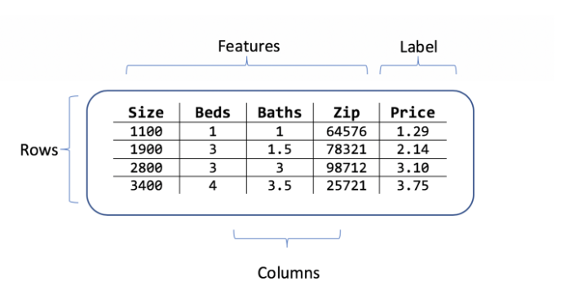
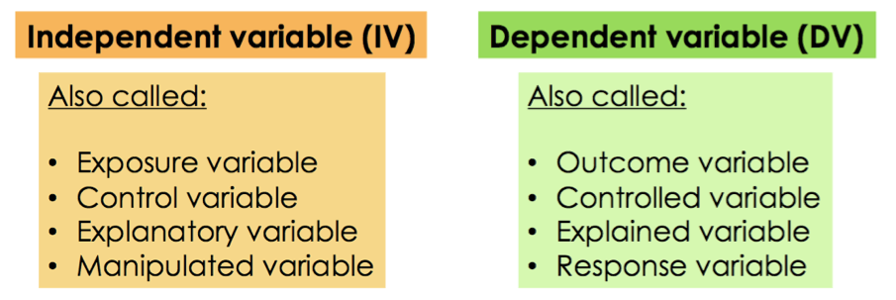
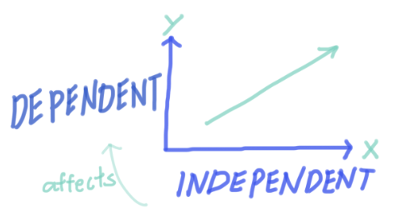

Slide 9
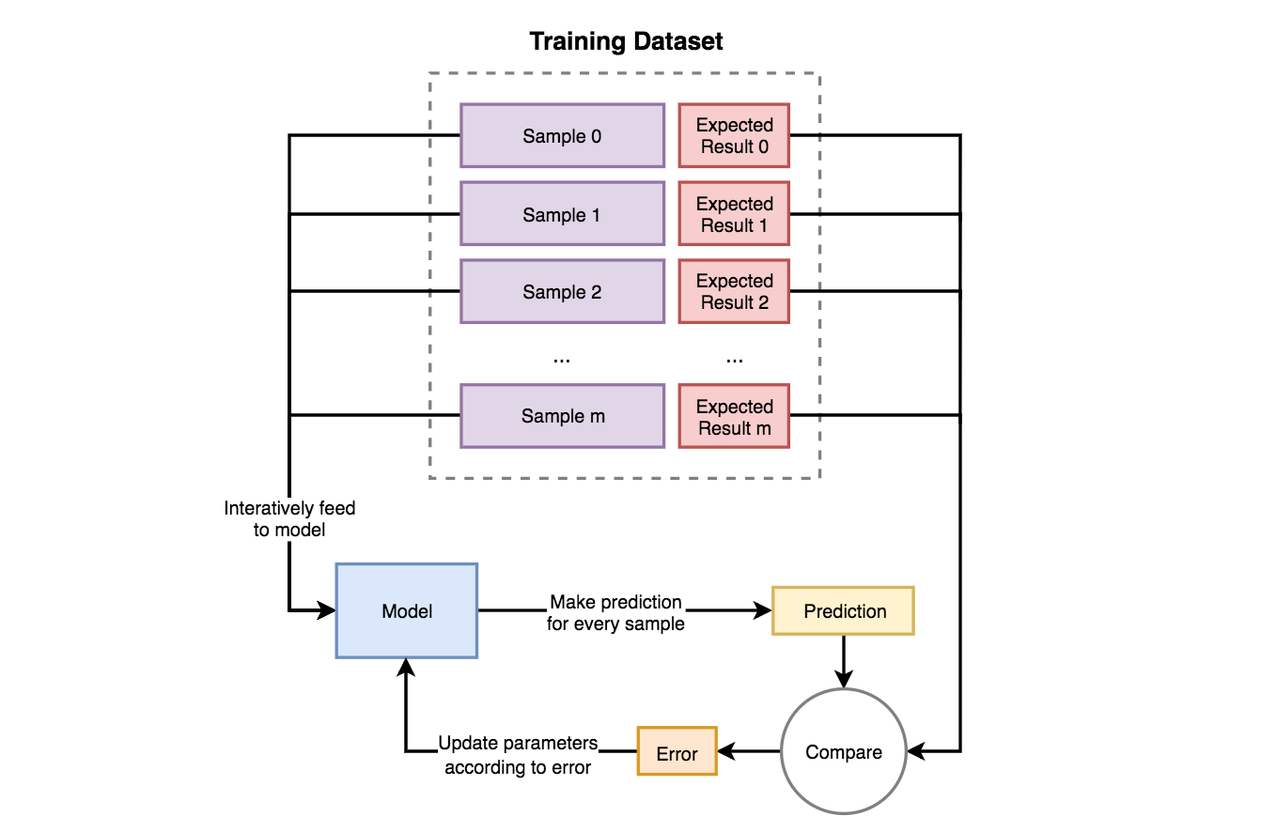

Slide 10
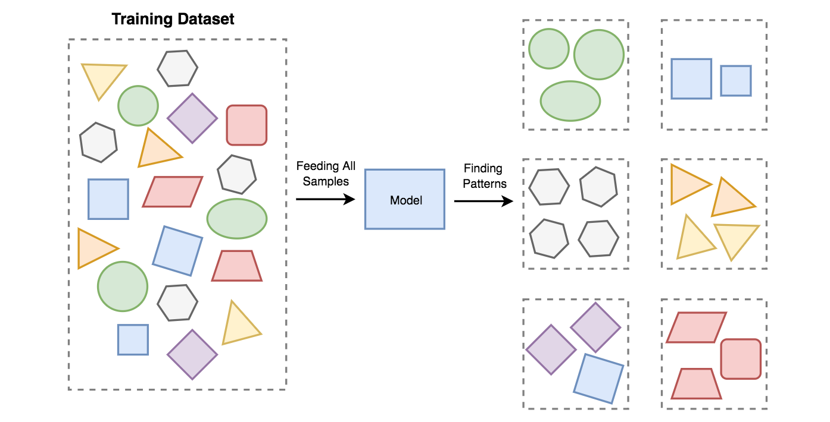

Slide 11
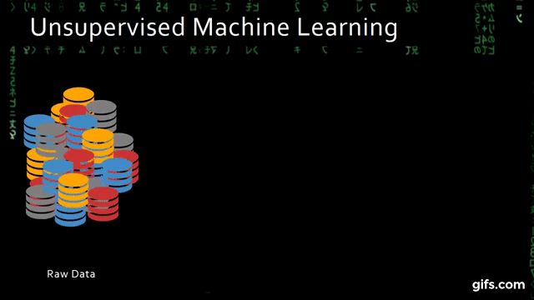

Slide 12
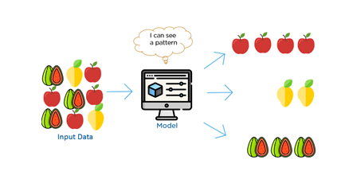
Unsupervised Learning- Unsupervised learning is very much the opposite of supervised learning. It features no labels. Instead, our algorithm would be fed a lot of data and given the tools to understand the properties of the data.
Itcan learn to group, cluster, and/or organize the data in a way such that a human (or other intelligent algorithm) can come in and make sense of the newly organized data.

Slide 13
Unsupervised Learning- Applications
Recommender Systems
Buying Habits
Grouping User Logs
Unsupervised Learning- Types
Unsupervised Learning has been split up majorly into 2 types:
Clustering
Association

Slide 14
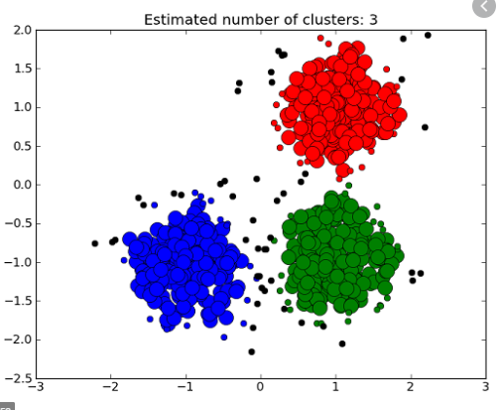
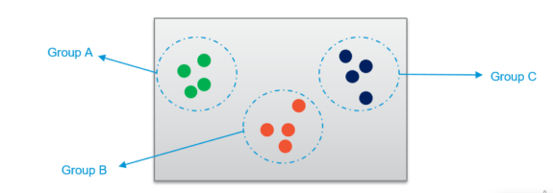
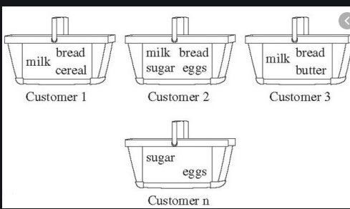

Slide 15
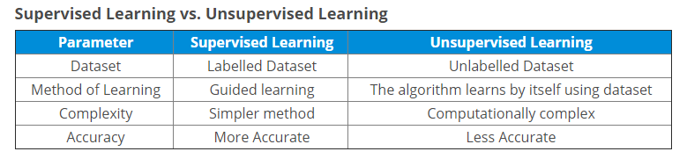
Difference

Slide 16
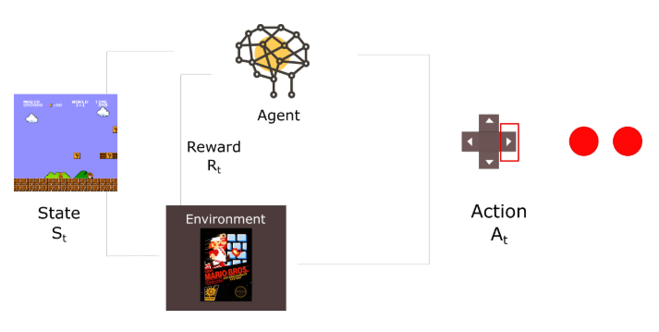
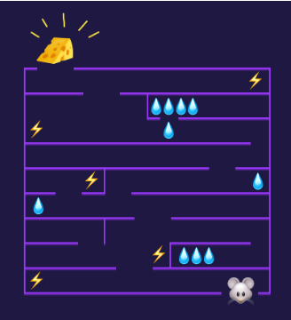
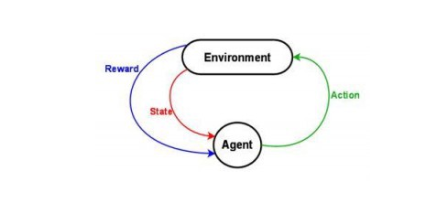
Which ML type ?

Slide 17
Reinforcement Learning
Reinforcement learning is fairly different when compared to supervised and unsupervised learning.
I prefer to look at reinforcement learning as learning from mistakes. Place a reinforcement learning algorithm into any environment and it will make a lot of mistakes in the beginning.
We can reinforce our algorithm to prefer good behaviors over bad ones. Over time, our learning algorithm learns to make less mistakes than it used to.

Slide 18
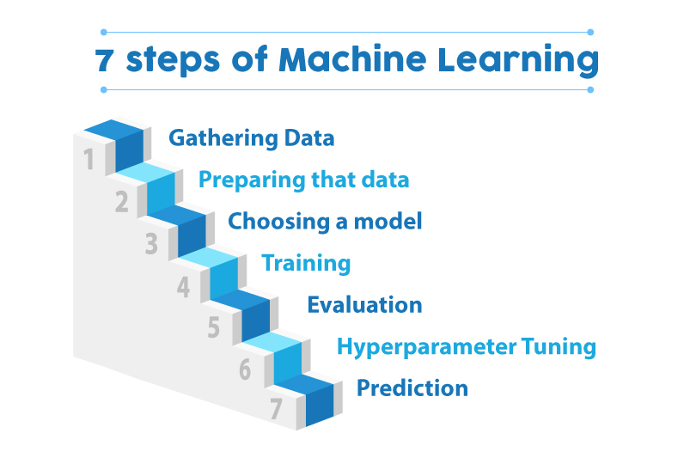

Slide 19
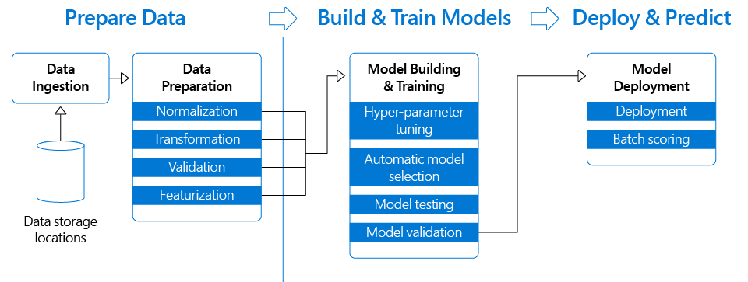

Slide 20
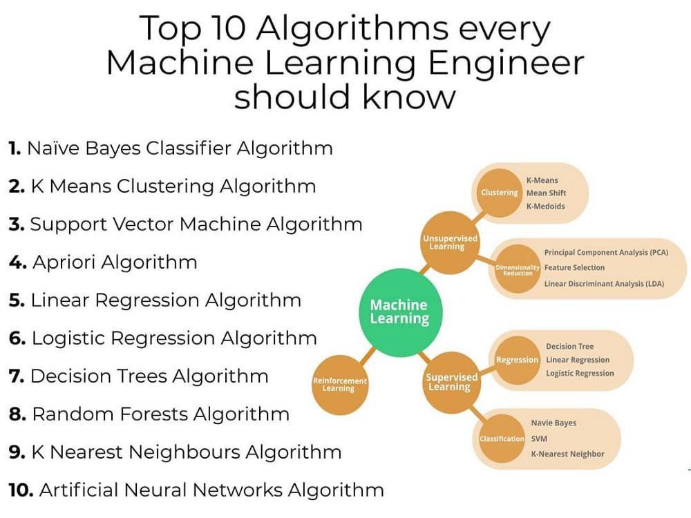

Slide 21


Slide 22
Which one is the Application of Clustering ?
01
Fraud Detection
02
Real Time Decisions
03
User Segmentation

Slide 23
If a company's sales have increased steadily every month for the past few years, by conducting which analysis on the sales data with monthly sales, the company could forecast sales in future months
01
Linear Regression Algorithm
02
K means Algorithm
03
Naive Bayes Algorithm

Slide 24
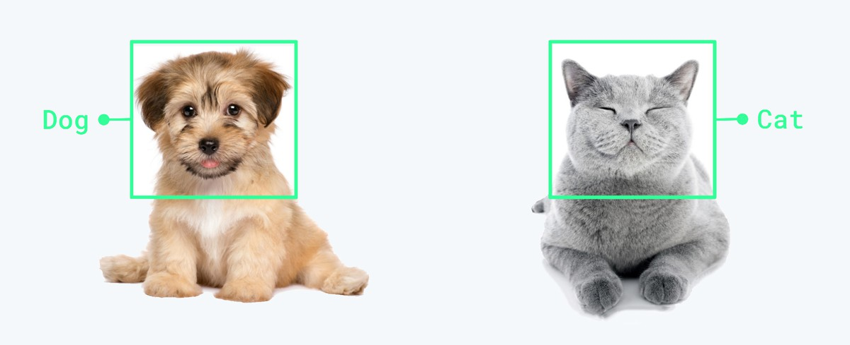
What type of Algorithm can be used to classify its a Cat or Dog ??

Slide 25

How we see a Cat but How computer sees a Cat .. Oh its complex Right ??

Slide 26
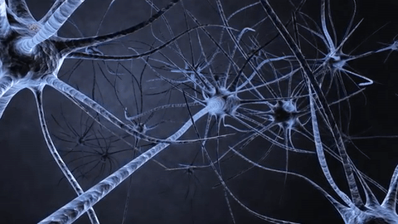
Neural Networks

Slide 27
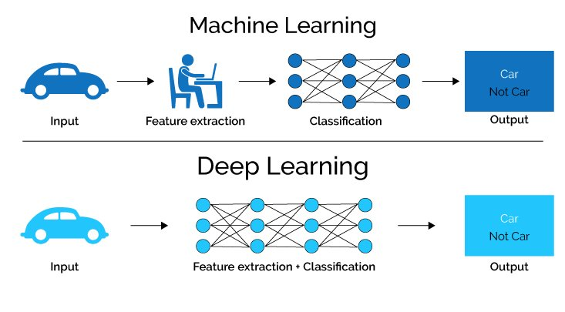
Machine Learning Vs Deep Learning

Slide 28


Slide 29
What is Python?
Python is a general-purpose interpreted, interactive, object-oriented, and high-level programming language.
Python is an easy to learn, powerful programming language. It has efficient high-level data structures and a simple but effective approach to object-oriented programming.
Python’s elegant syntax and dynamic typing, together with its interpreted nature, make it an ideal language for scripting and rapid application development in many areas on most platforms.

Slide 30
What is the main use of Python?
1- Desktop applications (GUI based)
2– Web applications
3– Gaming applications
4– Software development purposes
5– Machine learning(ML) along with Artificial intelligence(AI).
6– Data analysis and Data Visualization

Slide 31
Advantages of using Python
1- Open Source
2- Ease to Learn
3- Compatible with many third party libraries.
4- Less coding involved
5- Python for Everyone
6-Increase Productivity
7- Friendly Data Structures
8- Easy Integration with other languages
9- Portability

Slide 32
Why Learn Python?
This is one of the best programming languages. it is a very simple and user-friendly open source programming language so it is being used widely by software engineers, Freshers, Data scientists.
Which companies are using python?
Google
Facebook
Netflix
Uber
Instagram
Spotify
Quora
Dropbox
Reddit
YouTube
Amazon
Python developers are in very much demand because of the growth of Machine learning(ML) and the Artificial Intelligence(AI) sector where it is used heavily.

Slide 33
Data Types in Python
Below is the list of important data types that are commonly used in Python. We’ll discuss each of them with examples.
Booleans
Numbers
Strings
Bytes
Lists
Tuples
Sets
Dictionaries

Slide 34
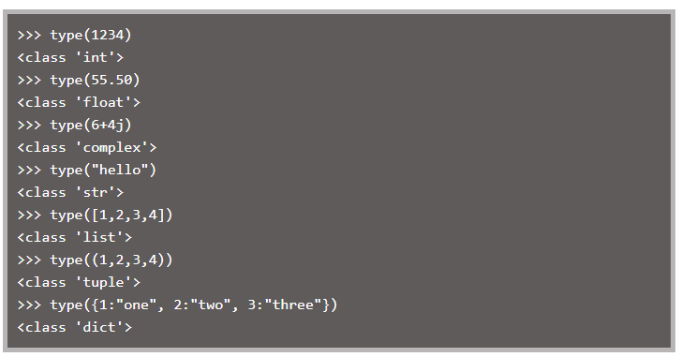

Slide 35
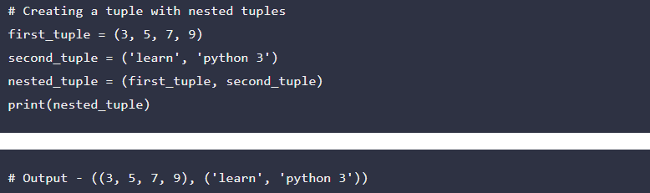
Lists: It is a collection of items of varied data types. For example, a list object can store the files in a folder, or the employee data in a company etc.
Tuples: A tuple is a heterogeneous collection of Python objects separated by commas. It means objects of different data types can co-exist in a tuple.
fk

Slide 36
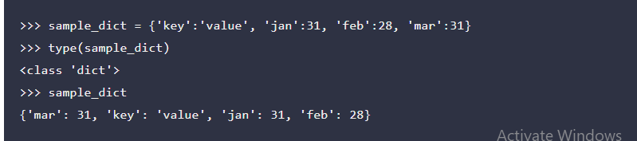
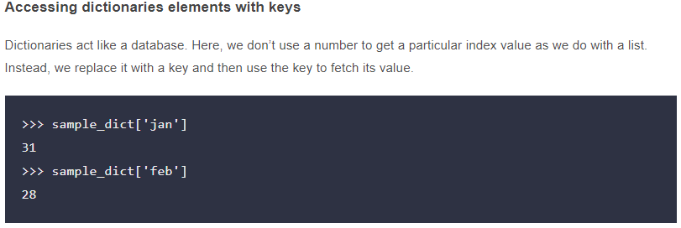
Dictionaries :A dictionary in Python is an unordered collection of key-value pairs. It’s a built-in mapping type in Python where keys map to values.
fk

Slide 38
Simple Linear Regression

Slide 39
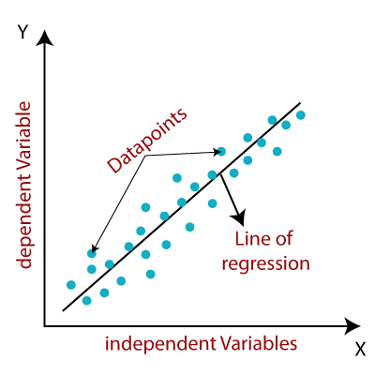

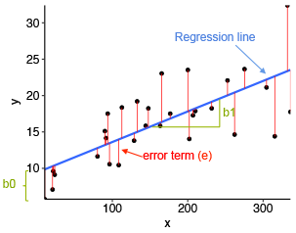
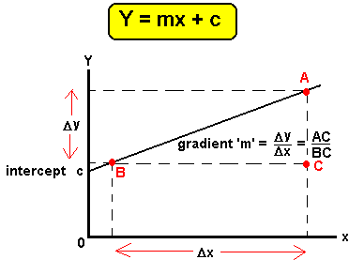

Slide 40
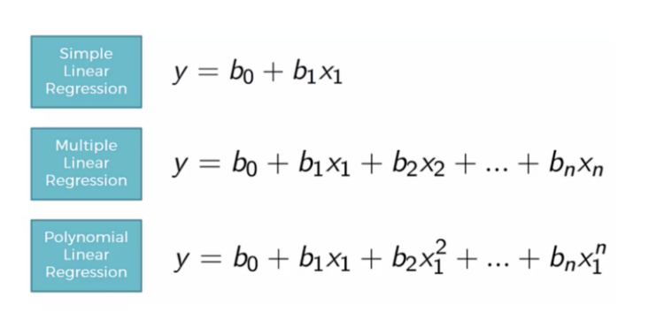
Predict Salary using Simple Linear and Polynomial Regression

Slide 41
Lets Codes

Slide 42
Classification Problem

Slide 43

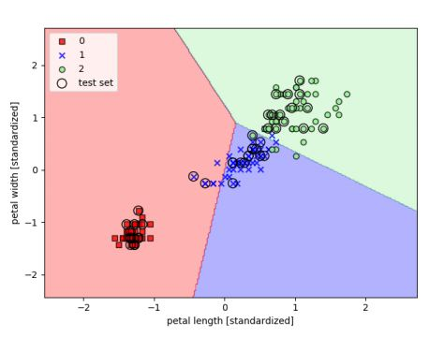

Slide 44
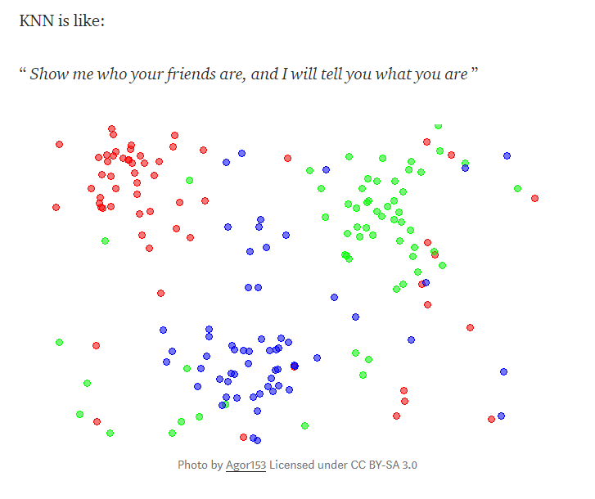

Slide 45
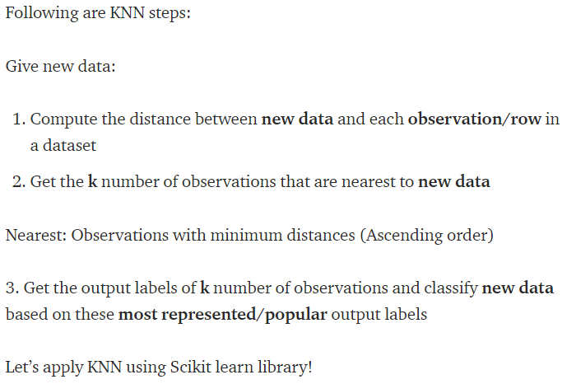

Slide 46
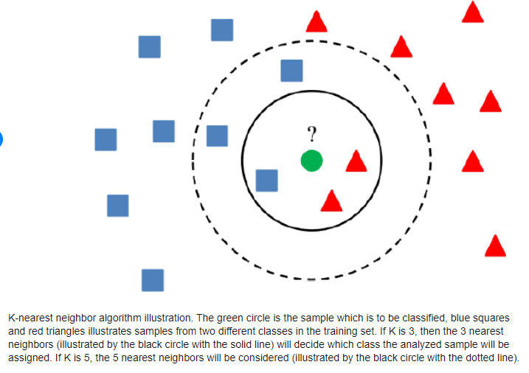

Slide 47
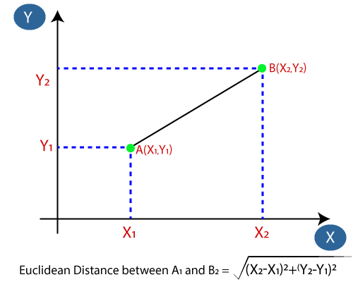
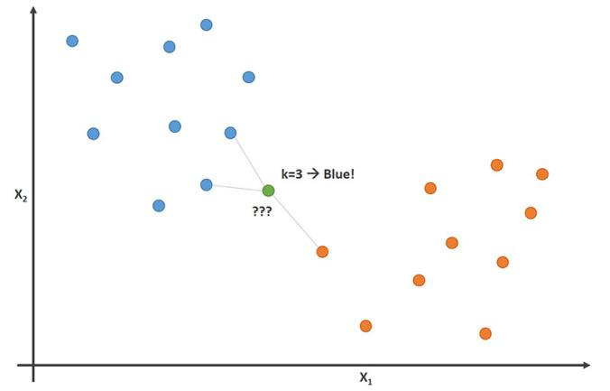

Slide 48
Lets Codes

